Slide 1

Network Layer: IPv6 Addressing
Computer Communication and Networks
Session 14
Tutor: Karma Wangchuk

Slide 2

Network Layer
Learning Outcome:- At the end of the lesson, you are expected to be able to:
  Introduction
  Discuss IPv6 Addressing.
  Identify Five RIRs
  Discuss Address Allocation
  Demonstrate Addressing Plans

Slide 3
Network Layer: IPv6
Introduction
  The network layer protocol on the Internet is currently IPv4.
  IPv4 provides the host-host communication systems on the Internet.
  Although IPv4 is well designed, data communications has evolved a lot since it was introduced in the 1970s.
  IPv4 has some deficiencies that make it unsuitable for the fast-growing Internet.
  IPv4 has a two-level addresses structure (netid and hostid) categorized into five classes which is an inefficient use of the address space.

Slide 4
Network Layer: IPv6
Introduction
The modern internet must accommodate real-time audio and video transmission.
  This type of transmission requires minimum delay strategies and reservation of resources not provided in the IPv4 design.
The internet must accommodate encryption and authentication of data.
  IPv4 does not provide any security measures.
Internet Protocol version 6 (IPv6) or Internetworking Protocol, next-generation (IPng) was proposed and is now a standard

Slide 5
Network Layer: IPv6
Internet Protocol: IPv6
IPv4 has some deficiencies that make it unsuitable for fast-growing Internet.
  Address depletion.
  The Internet must accommodate the real-time audio & video transmission.
  It requires minimum delay strategies & resource reservation which doesn’t provide in IPv4.
  The Internet must accommodate encryption and authentication of data for some applications. No encryption and authentication are provided by IPv4.
To overcome these deficiencies, IPv6 was proposed and is now standard.

Slide 6
Network Layer: IPv6
Internet Protocol: IPv6
What is IPv6?
  Layer 3 Internet Protocol Version 6
  The internet's next-generation protocol intended to replace IPv4
  IPv6 became a draft standard in December 1998, but did not formally become an Internet Standard until 14 July 2017
  Why IPv6?
  IPv4 supports only about 4.3 billion addresses
  IPv4 IP addresses ran out by February 2011

Slide 7
Network Layer: IPv6
Internet Protocol: IPv6
  Larger Address space is provided in IPv6.
  IPv6 is 128 bits or 16 bytes long against 32 bits or 4 bytes of IPv4.
  Address space of IPv6 contains 2¹²⁸ (about 2⁹⁶ times of IPv4 address space)
  This was done so that in the future when household appliances also become a part of the Internet they can have a sufficient number of addresses

Slide 8
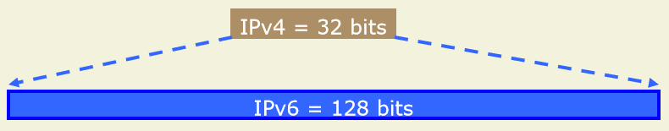
Network Layer: IPv6
Internet Protocol: Larger Address Space
  IPv4
    32 bits
    = 4,294,967,296 possible addressable devices
  IPv6
    128 bits: 4 times the size in bits
    = 3.4 x 10³⁸ possible addressable devices
    = 340,282,366,920,938,463,463,374,607,431,768,211,456
    ~ 5 x 10²⁸ addresses per person on the planet

Slide 9
Network Layer: IPv6
Internet Protocol: IPv6
IPv6 has a better header format.
IPv6 uses a new header format in which options are separated from the base header and inserted as required.
  This simplifies the routing process.
Support for more security.
  The encryption and authentication options in IPv6 provide confidentiality and integrity of the packet.

Slide 10
Network Layer: IPv6
Internet Protocol: IPv6
  The format and length of the IP address changed along with the packet format
  ICMP were modified and named ICMP v6.
  Other protocols in the network layers, such as ARP, RARP, and IGMP were deleted.
  Routing protocols such as RIP and OSPF are slightly modified.
Notes:
Open Shortest Path First, Routing Information Protocol

Slide 11
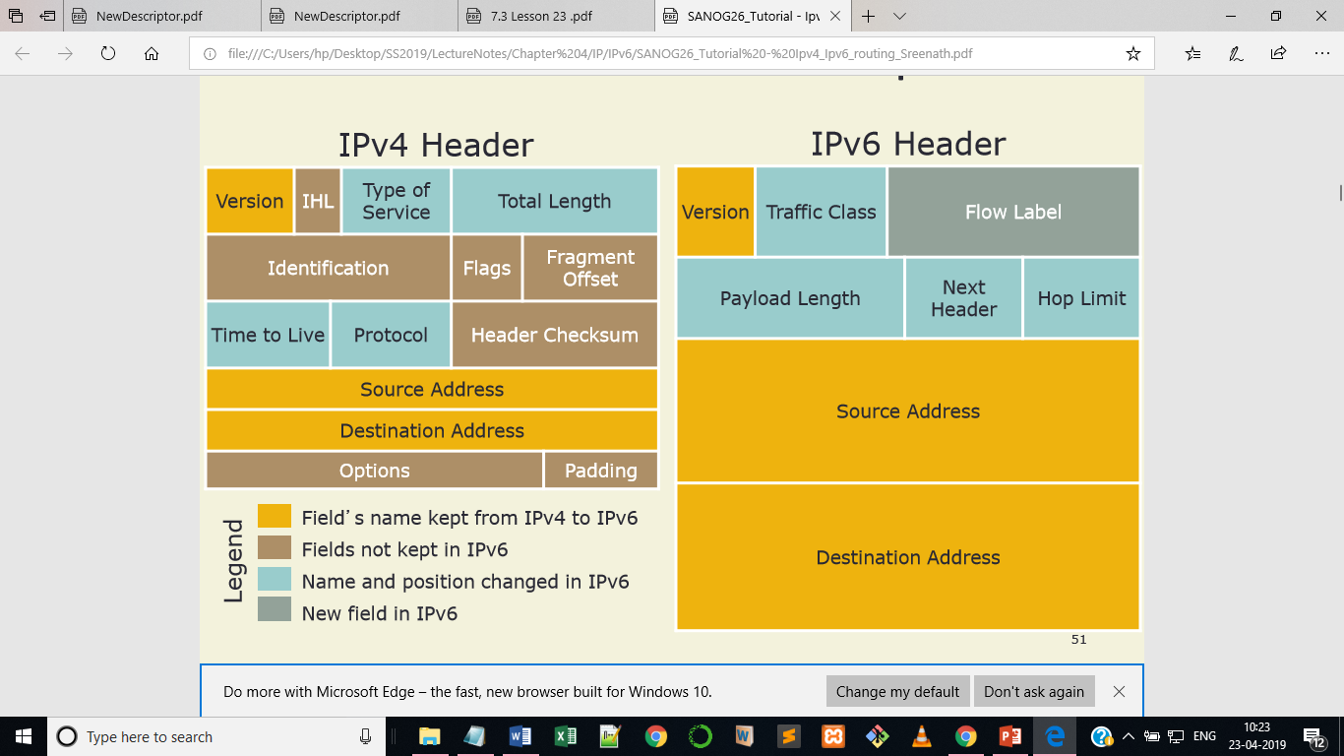
Network Layer: IPv6
Internet Protocol: IPv4 and IPv6 Header Comparison
Notes:
IHL-Internet Header Length

Slide 12
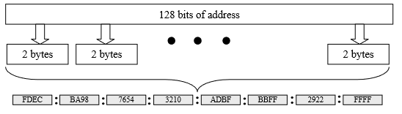
Network Layer: IPv6
IPv6: Addresses Representation
  An IPv6 address consists of 128 bits or 16 bytes.
  To make the address more readable, IPv6 specifies hexadecimal colon notation the use of which can be explained with the help of figure below:

Slide 13
Network Layer: IPv6
Internet Protocol: IPv6 Representation
  Notations:
      Dotted-Decimal: 221.15.24.45.56.34.12.34.90.23.24.35.43.150.200.255
      Colon Hexadecimal: FDEC:0000:0000:0000:0000:BBFF:0000:FFFF
          Abbreviated address: FDEC:0:0:0:0:BBFF:0:FFFF
          After zero compression(further abbreviated): FDEC::BBFF:0:FFFF
          Zero compression is allow only once per address.
          CIDR notation: FDEC::BBFF:0:FFFF/60

Slide 14
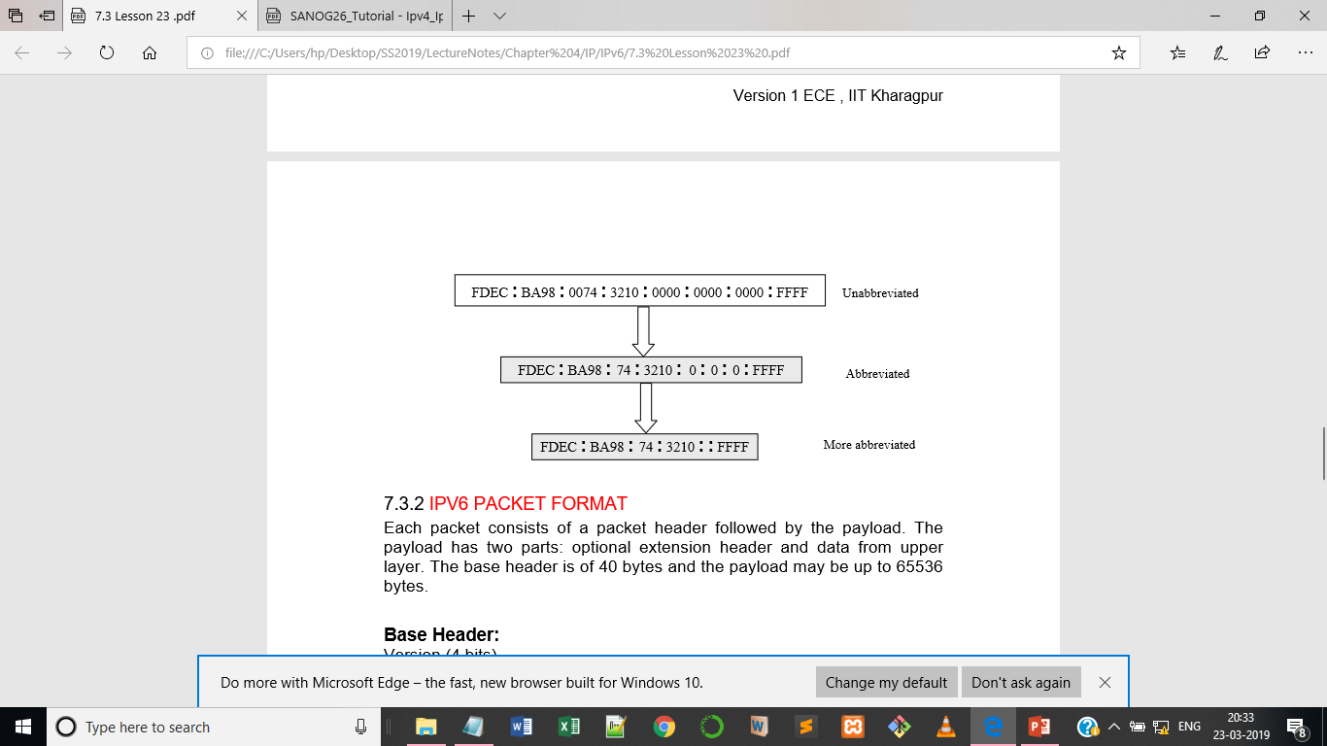
Network Layer: IPv6
Internet Protocol: IPv6
  Colon Hexadecimal

Slide 15
Network Layer: IPv6
Internet Protocol: IPv6 Representation
  16 bit fields is case insensitive colon hexadecimal representation
    2031:0000:130F:0000:0000:09C0:876A:130B
    2001:db8::/32
  Leading zeros in a field are optional:
    2031:0:130F:0:0:9C0:876A:130B
  Successive fields of 0 represented as ::, but only once in an address:
    2031:0:130F::9C0:876A:130B is ok
    2031::130F::9C0:876A:130B is NOT ok

Slide 16
Network Layer: IPv6
Internet Protocol: IPv6 Representation
  Prefix Representation
    Representation of prefix is just like IPv4 CIDR
    In this representation you attach the prefix length
    Like IPv4 address:
      198.10.0.0/16
    IPv6 address is represented in the same way:
      2001:db8:12::/40
      https://ip.sb/cidr/ 🡪Detail about IPv6 slash notation.

Slide 17
Network Layer: IPv6
Internet Protocol: IPv6 Representation
  IPv6 Addressing rules are covered by multiple RFCs
      Architecture defined by RFC 4291
  Address Types are :
      Unicast: One to One (Global, Unique Local, Link-local)
      Anycast: One to Nearest (Allocated from Unicast)
      Multicast: One to Many
  A single interface may be assigned multiple IPv6 addresses of any type (unicast, anycast, multicast)
      No Broadcast Address 🡪 Use Multicast
Notes:
RFC-request for comments

Slide 18
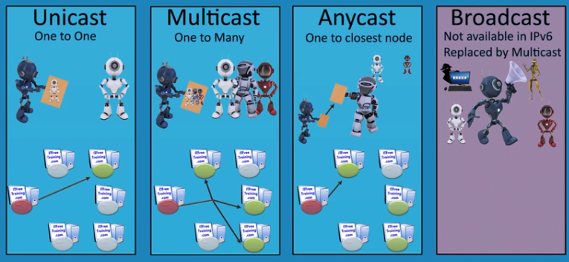
Network Layer: IPv6
IPv6: Types of IPv6 Addresses

Slide 19
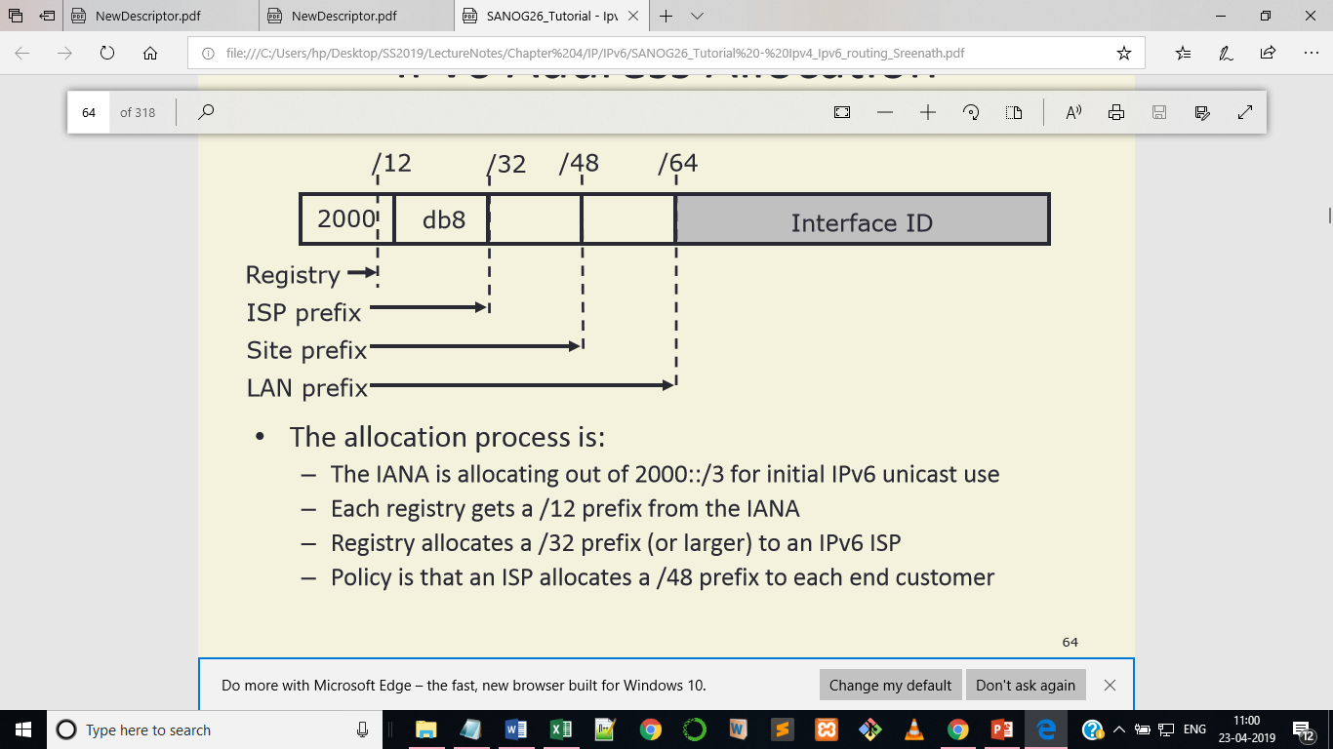
Network Layer: IPv6
Internet Protocol: IPv6 Address Allocation

Slide 20
Network Layer: IPv6
Internet Protocol: IPv6 Representation
  64 bits reserved for the interface ID
      Possibility of 264 hosts on one network LAN
      In theory 18,446,744,073,709,551,616 hosts
      Arrangement to accommodate MAC addresses within the IPv6 address.
  How to get an IPv6 Address?

Slide 21
Network Layer: IPv6
Internet Protocol: How to get IPv6 Addresses?
  IPv6 address space is allocated by the 5 RIRs (Regional Internet Registries):
      AfriNIC 🡪 Africa http://www.afrinic.net
      APNIC 🡪 Asia and Pacific http://www.apnic.net
      ARIN 🡪 North America http://www.arin.net
      LACNIC🡪 Latin America and the Caribbean http://www.lacnic.net
      RIPE NCC 🡪 Europe and Middle East http://www.ripe.net/info/ncc
  ISPs get address space from the RIRs
  Enterprises get their IPv6 address space from their ISP

Slide 22
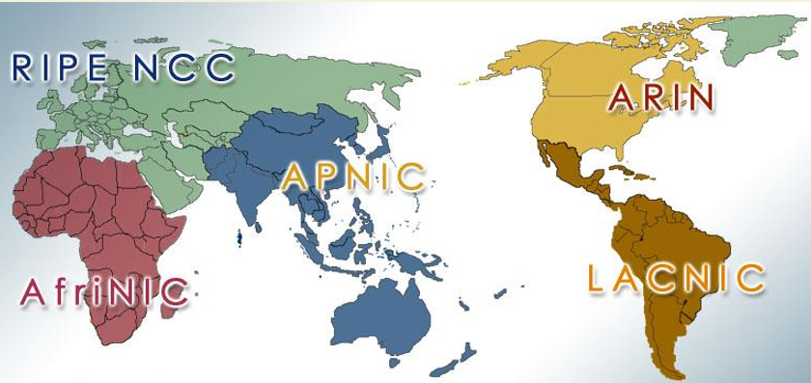
Network Layer: IPv6
Internet Protocol: Where to get IPv6 Addresses?
  5 Regional Internet Registries (RIRs):

Slide 23
Network Layer: IPv6
IPv6: Subnetting
  Global Routing Prefix
      The network ID or prefix of the address
  Subnet ID
      A number that identifies a subnet within the site
  Interface ID:
      The unique identifier for a particular interface (host or other devices)
      It is unique within the specified prefix and subnet.
128- bits
48- bits
16- bits
64- bits
16 | 16 | 16 | 16 | 16 | 16 | 16 | 16
Global Routing Prefix
Subnet ID
Interface ID

Slide 24
Network Layer: IPv6
IPv6: Subnetting
  RIR
      Subnetting within 32 bits and give it to ISP
  ISP
      Subnet within /16 within the ISP and forwards /16 to the customer
  Interface ID:
      The unique identifier for a particular interface (host or other device)
      It is unique within the specific prefix and subnet.
128- bits
64- bits
64- bits
/32 | /16 | /16 | 64
RIR
ISP
Customers
Interface ID

Slide 25
Network Layer: IPv6
128- bits
48- bits
16- bits
64- bits
16 | 16 | 16 | 16 | 16 | 16 | 16 | 16
IANA
ICANN
RIR
APNIC
ISP
Tcell
BT
Subnet ID
Interface ID

Slide 26
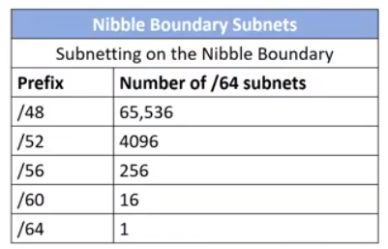
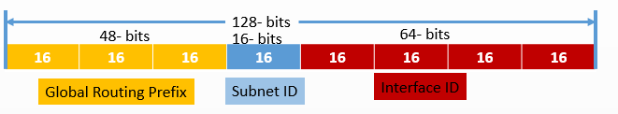
Network Layer: IPv6
IPv6: Nibble Boundaries
  Subnetting based on nibble boundaries.
    Jumps by 4 bits for each subnet
    Any change in multiples of 4 bits is easy to calculate

Slide 27
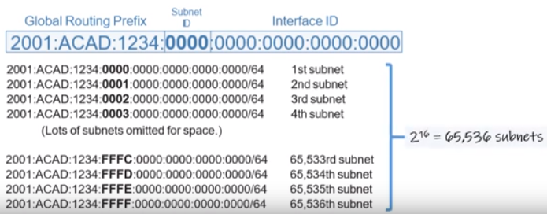
Network Layer: IPv6
IPv6: Nibble Boundaries Subnetting
  ISP assigns 2001:ACAD:1234::/48

Slide 28
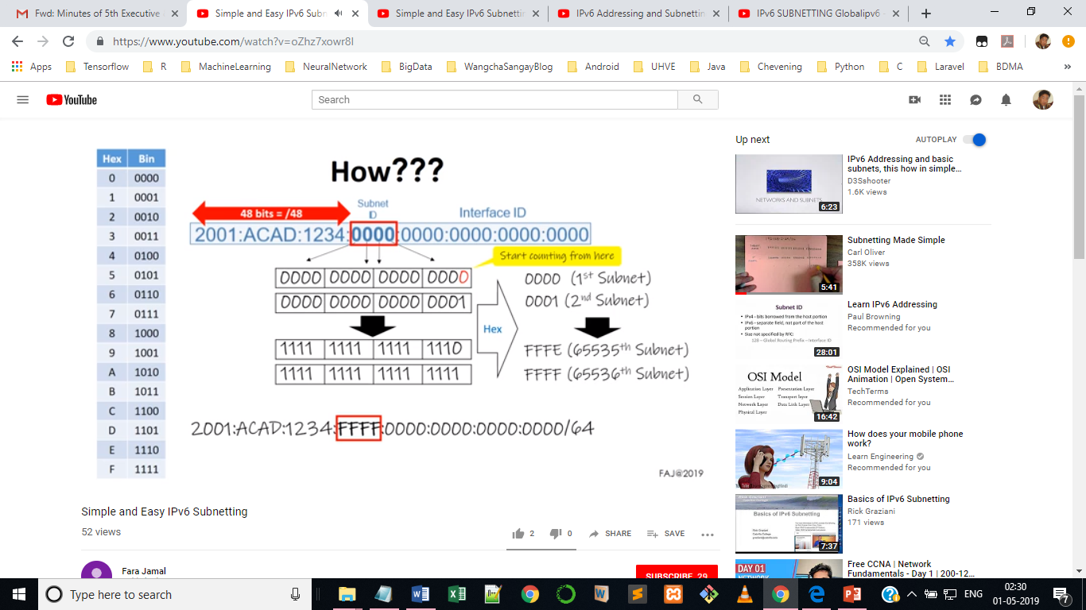
Network Layer: IPv6
IPv6: Nibble Boundaries Subnetting

Slide 29
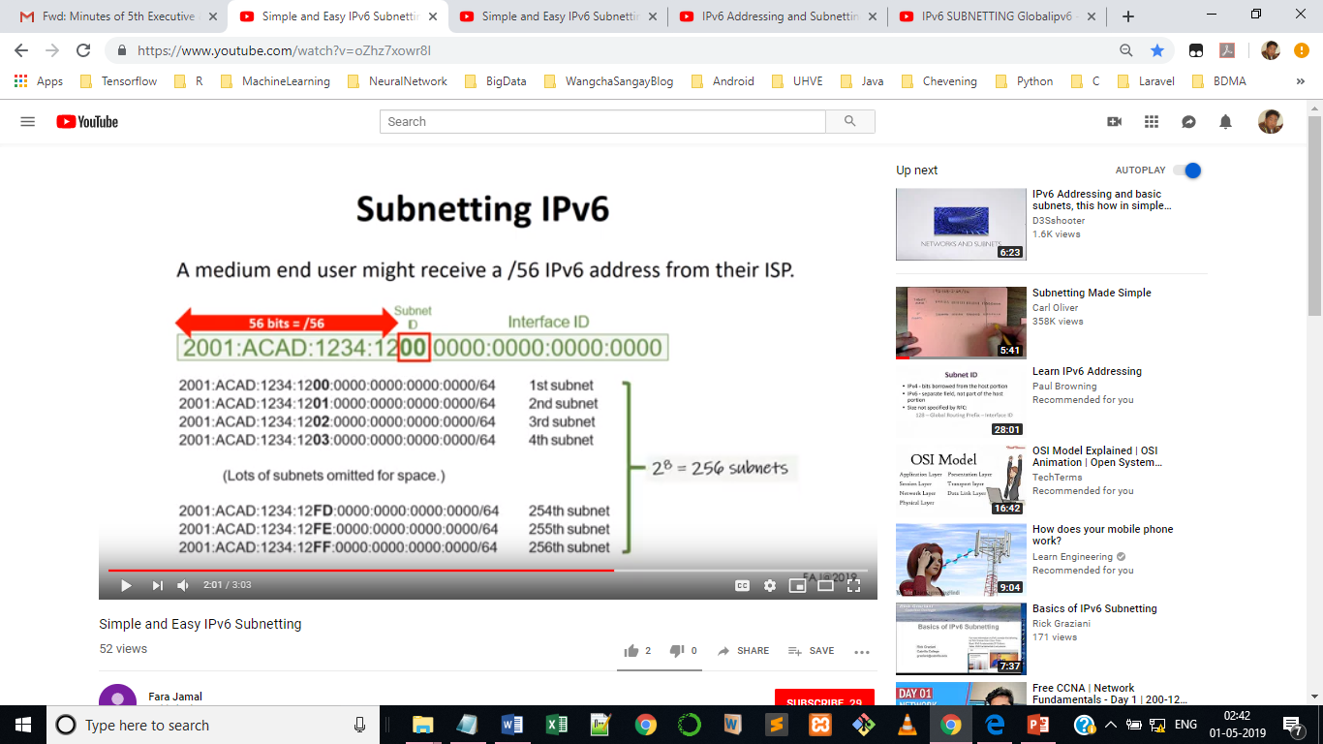
Network Layer: IPv6
IPv6: Nibble Boundaries Subnetting
  A medium user might receive a /56 IPv6 address from their ISP

Slide 30
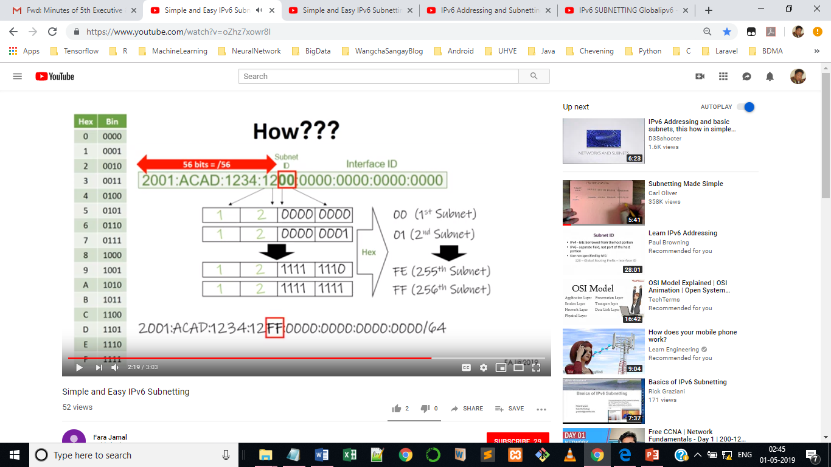
Network Layer: IPv6
IPv6: Nibble Boundaries Subnetting

Slide 31
Network Layer: IPv6
IPv6: Nibble Boundaries Subnetting
  List all the subnets if the ISP assigns 2001:ACAD:1234::/60.

Slide 32
Network Layer: IPv6
IPv6: Nibble Boundaries Subnetting
  Let’s say we have an allocation: 2001:db8::/32. Taking slices from this pool within a 4-bit boundary is quite easy.
      What are the subnets with /36, /40, /44 and /48?
/36 slices (1 x 4 bits)
2001:db8:0000::/36
2001:db8:1000::/36
2001:db8:2000::/36
and so on…
/44 slices (3 x 4 bits)
2001:db8:0000::/44
2001:db8:0010::/44
2001:db8:0020::/44
/40 slices (2 x 4 bits)
2001:db8:0000::/40
2001:db8:0100::/40
2001:db8:0200::/40
/48 slices (4 x 4 bits)
2001:db8:0000::/48
2001:db8:0001::/48
2001:db8:0002::/48

Slide 33
Network Layer: IPv6
IPv6: Host Portion
  How is the host portion of the IPv6 address is assign to the host?
    2FFB:0:0:1000::42/64
      First 64 bits are for network ID
      Host resides in subnet 1000.

Slide 34
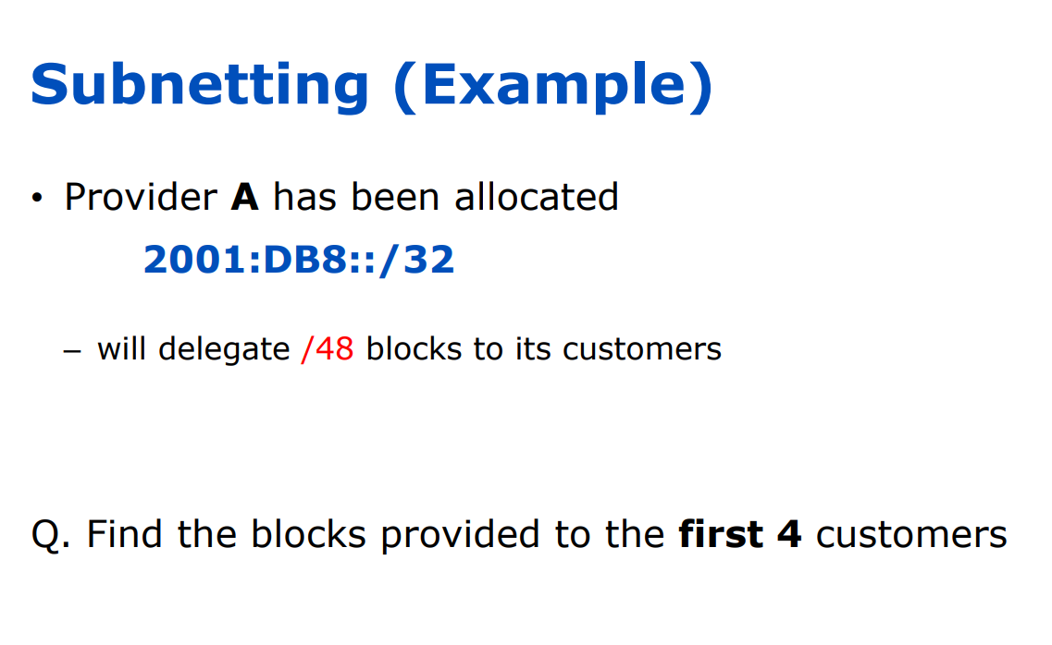
Network Layer: IPv6

Slide 35
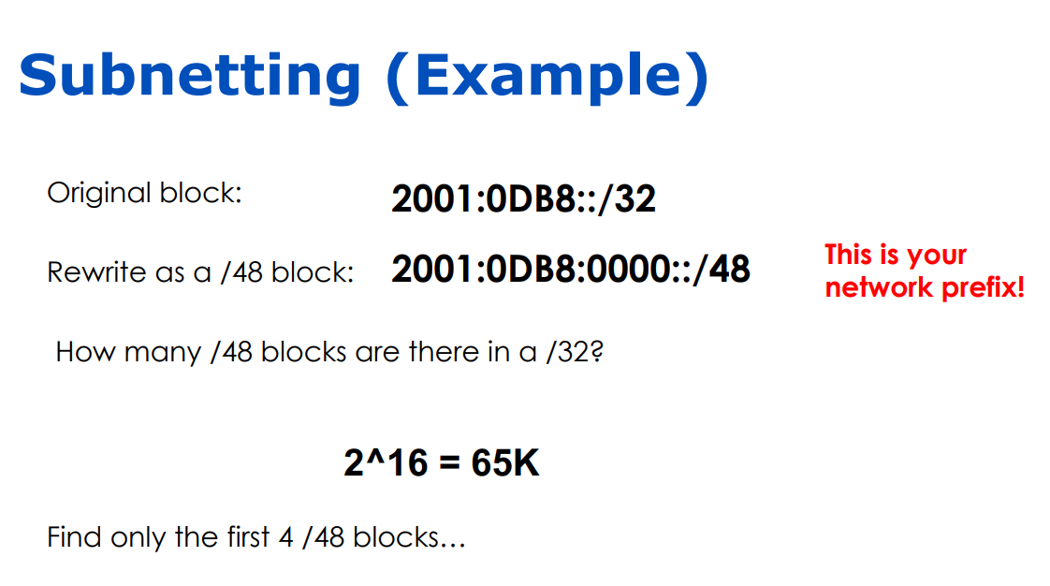
Network Layer: IPv6

Slide 36
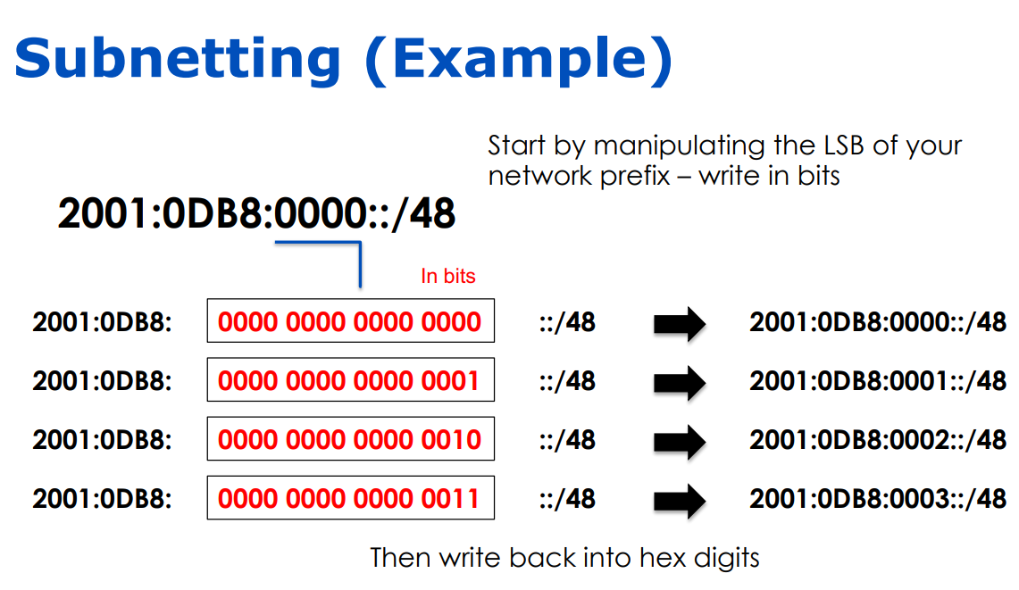
Network Layer: IPv6

Slide 37
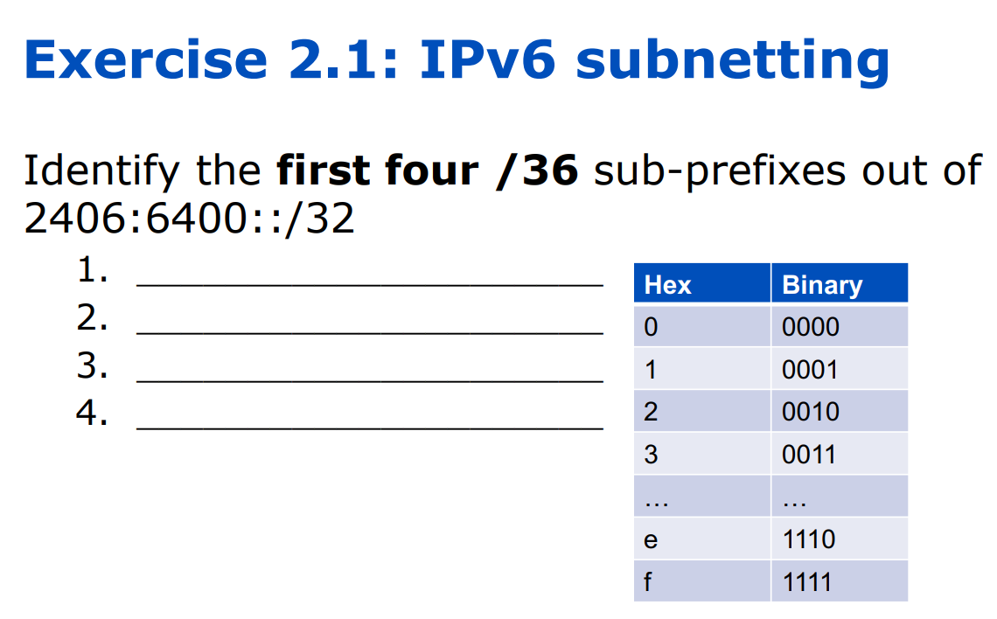
Network Layer: IPv6

Slide 38
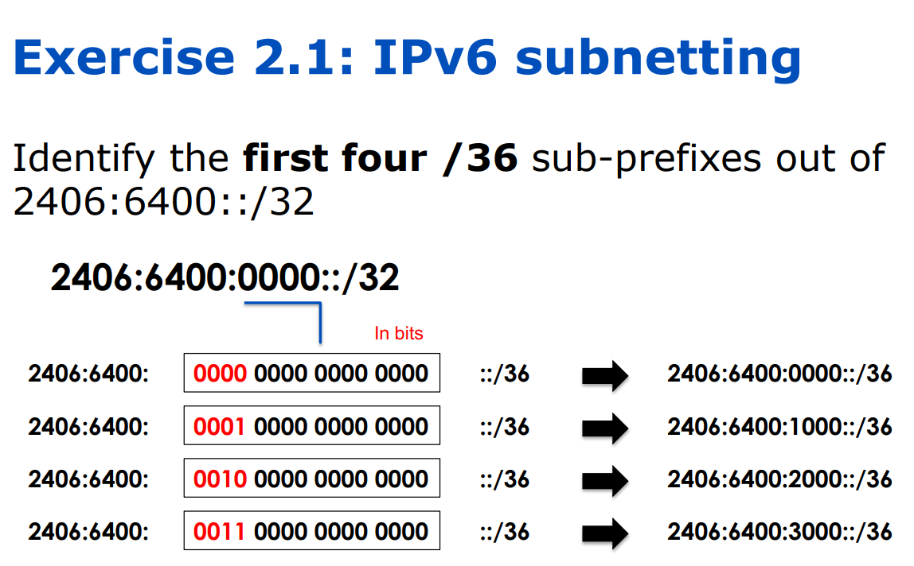
Network Layer: IPv6

Slide 39
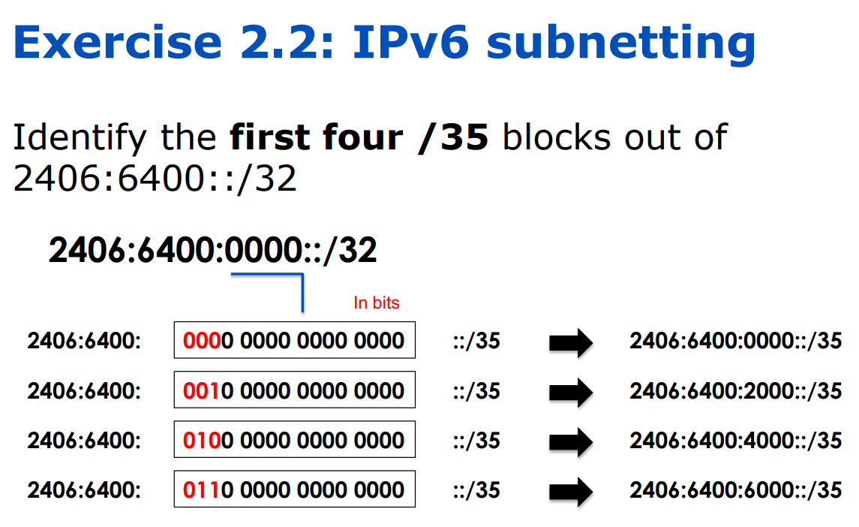
Network Layer: IPv6

Slide 40
Network Layer: IPv6
Internet Protocol: loopback Device and Address
  The loopback device is a special, virtual network interface that your computer uses to communicate with itself.
  It is used mainly for diagnostics and troubleshooting, and to connect to servers running on the local machine.
  Loopback Device has loopback address:
    IPv4 127.0.0.1
    IPv6 ::1
    127.0.0.1 is also known as localhost

Slide 41
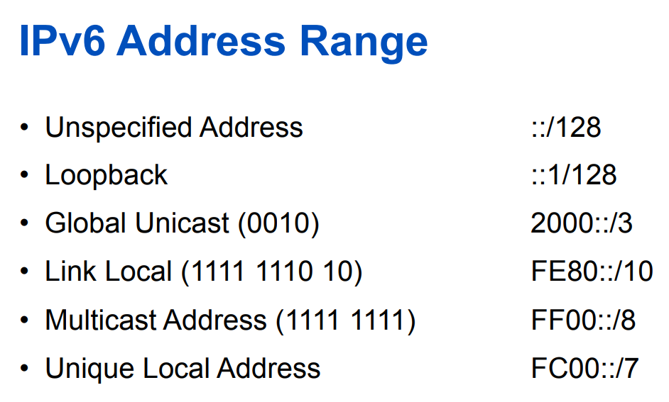
Network Layer: IPv6

Slide 42
References
References:
  Stallings, W., Data & Computer Communication, Prentice-Hall
  Tanenbaum, Computers Networks, PHI
  Forouzan, B.A., Data Communication & Networkings, 4th Edition.
  Mr. Yeshi Wangchuk’s CCN Class Slides (2014), College of Science and Technology, Rinchending, Phuentsholing, Bhutan
  https://www.crucial.com.au/blog/2011/04/15/ipv6-subnet-cheat-sheet-and-ipv6-cheat-sheet-reference/
  https://docs.netgate.com/pfsense/en/latest/network/ipv6/subnets.html
  https://github.com/onemarcfifty/cheat-sheets/blob/main/networking/ipv6.md

